Slide 1
INTRODUCTION TO HIV/AIDS.
INTRODUCTORY BLOCK.

Slide 2
BROAD OBJECTIVES.
By the end of this section, the student will be able to acquire knowledge and understanding of the general cause of disease, behaviour related to disease causation , and factors involved in infections.

Slide 3
Specific objectives.
Definition of terms
Pathophysiology and life cycle of HIV.
WHO staging
Introduction to HAART
Clinical HIV Counselling and testing.

Slide 4
DEFINITION OF TERMS.
TERM | DEFINITION.
HIV | Retrovirus, isolated and recognized as etiologic agent of AIDS.
AIDS | Acquired Immune deficiency syndrome.
Immunity | The body’s specific protective response to a foreign agent or organism: resistance to disease, specifically infectious disease.
Immune deficiency | A state in which the immune system’s ability to fight infections is compromised or completely absent.
Window period. | Time from infection with HIV until seroconversion detected on HIV antibody test.

Slide 5
INTRODUCTION.
HIV belongs to a family called retroviruses and the sub-group lentivirus.
Retroviruses are a unique group of viruses in that they go against the conventions of genetics. What do we mean by this? You may have learned in your high school or college biology that RNA is made from DNA.
Retroviruses defy this convention and are able to form DNA from RNA! The reason for doing this, as we shall see in the pathophysiology sub-section below, is to be able to use the human cell mechanisms.

Slide 6
PATHOPHYSIOLOGY AND LIFE CYCLE OF HIV.

Slide 7
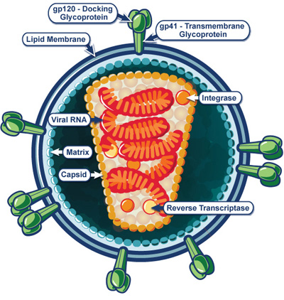

Slide 8
Structure of the HIV .
The virus has an outer double lipid membrane that is derived from the host membrane. This is studded with spikes known as the surface glycoprotein (gp) 120 which is anchored to the lipid membrane by the trans-membrane gp41.
The gp120 and gp41 mediate the entry of virus into the host cells. The lipid membrane has an inner lining of protein matrix.
Inside the protein matrix layer is a cone-shaped protein core. The core (capsid) is made up of the protein p24 that encapsulates two identical pieces of single strand RNA (ssRNA) ,( the viral genetic material ) and viral enzymes.

Slide 9
STRUCTURE OF THE HIV VIRUS.
These enzymes include reverse transcriptase (RT), Integrase (I), and Protease (P) enzymes, which perform different functions in the viral replication process.
Reverse transcriptase is used for replication of the virus genetic material by converting the viral ssRNA into a double stranded deoxyribonucleic acid (DNA).
The integrase enzyme facilitates integration of the DNA into the host’s chromosomal DNA.
The protease enzyme splits generated macro-proteins into smaller viral proteins (core, envelope, and regulatory proteins and enzymes), which go into forming new viral particles.

Slide 10
LIFE CYCLE OF HIV.

Slide 11
LIFE CYCLE OF HIV.
There are seven steps that are involved in the replication of the HIV virus.
These steps are well synchronised with the aim that the virus will be able to change, use and divert the human (host) cells mechanisms to its favour.

Slide 12
Life cycle of HIV.
Step. | Description.
Binding | Attachment of the virus through the gp120 and gp41 to the CD4 cell receptor of the host cell. Thereafter, there is an interaction between a CD4 cell co-receptor and the gp120 complex.
Fusion and entry. | fusion of the membranes of the host cell with that of the virus.
Reverse trancription. | the virus has uncoated itself by engaging in the last two steps and only the nucleus and its contents (RNA reverse transcriptase, integrase, and other viral proteins) enter the host cell cytoplasm. Using one of its enzymes, reverse transcriptase, the virus is able to transform from a ssRNA to a DNA.
Integration. | HIV transforms from ssRNA into DNA to match the structure in the host cell’s nucleus: DNA. It is thus transported into the host nucleus and integrates into the host cell DNA. This is aided by the viral enzyme integrase. Once this happens, the cell becomes infected permanently until it dies.

Slide 13
Life cycle of HIV.
Step. | Description.
Protein production. | The infected host cell’s mechanisms are then taken over by the virus. As we all know, DNA gives rise to RNA, which is used to make proteins. The ssRNA becomes the genomic RNA material that will eventually start off this cycle again in the next cells it infects.
Viral assembly and budding. | The assembly of the proteins,enzymes, and ssRNA into virions. The ssRNA and proteins move to the cell surface,and new immature viruses bud off from the host cell taking with them part of the host cell’s membrane. These budding are said to leave ‘holes’ within the membrane of the host cell, a factor that contributes towards the death of the CD4 cells.
Virus maturation. | The protease enzyme is involved in this final step by way of releasing individual HIV proteins. It thus acts both within the host cell’s cytoplasm and after release of the virus.

Slide 14
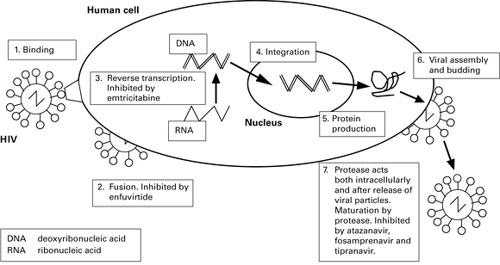
Life cycle of HIV.

Slide 15
PATHOPHYSIOLOGY.
Once HIV gets into the body, it attacks immune cells with CD4 receptors.
The destruction of these cells has a profound effect in the immune system,weakening virtually all its functions.

Slide 16
MODES OF HIV TRANSMISSION.
TRANSMISSION ROUTE | Percentage (%) of total transmissions
Sexual intercourse | 70-80%
Mother to Child transmission | 5-10%
Blood transfusion | 3-5%
Injecting drug use | 5-10%
Occupational exposure. | <0.01%
Notes:
Source: Modes of Transmissions Study, Kenya, 2009

Slide 17
WHO STAGING.

Slide 18
OBJECTIVES.
By the end of this lesson, the students should:
Discuss the components of enrolment into HIV care
Describe the initial assessment of an adult or adolescent living with HIV
Discuss routine clinical monitoring of PLHIV
Discuss routine laboratory monitoring of PLHIV

Slide 19
Once a patient is confirmed to be HIV-positive they should be enrolled into care.
Enrolment includes a discussion with the patient on what they should expect and what is expected of them.
As part of the enrolment visit into HIV care, you will need to perform an initial assessment of every patient.
The initial assessment includes a history, physical examination, WHO staging, and laboratory investigations(if available).

Slide 20
HISTORY
This should cover the following: age, sex, marital status, children, sexual history including partners and habits, any current illness, medical history (including current medications, chronic illnesses, previous OIs, previous major illnesses/hospitalizations/surgeries, drug allergies), drug use, and a review of systems.
In addition, inquire whether sexual partners have been tested for HIV and if not; ask for them to be invited (which may first require assisting them disclosure).
Ask for any children to be invited for an HIV test as well.
For women of reproductive age, find out their last normal menstrual period and establish their pregnancy status.

Slide 21
PHYSICAL
carry out a complete physical examination.
Look for any of the conditions listed in the WHO staging charts to assess how advanced the patient’s disease is.
The physical exam may also include cervical cancer screening for women who have ever been sexually active.

Slide 22
WHO STAGING.
WHO staging gives you an indication of the patient’s level of disease progression, with stage I being asymptomatic, and stage IV being advanced HIV or AIDS.
Document the stage in the patient’s file.

Slide 23
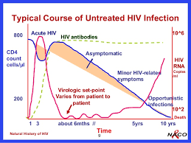
NATURAL HISTORY OF HIV.

Slide 24
WHO STAGING.
STAGE | MANIFESTATION
1 | Asymptomatic Persistent generalized lymphadenopathy.

Slide 25
WHO STAGING.
STAGE | MANIFESTATION.
2 | Moderate unexplained weight loss (< 10% of presumed body weight) • Recurrent respiratory tract infections • Herpes zoster • Angular cheilitis • Recurrent oral ulcerations • Papular pruritic eruptions • Seborrheic dermatitis • Fungal nail infections

Slide 26
WHO STAGING.
STAGE | MANIFESTATION.
3 | Unexplained severe weight loss (> 10% of presumed body weight) Unexplained chronic diarrhoea for more than one month Unexplained persistent fever (intermittent or constant, lasting for >1 month) Persistent oral candidiasis Oral hairy leukoplakia Pulmonary tuberculosis Severe bacterial infections (e.g. pneumonia, empyema, meningitis) Acute necrotizing ulcerative stomatitis, gingivitis or periodontitis Unexplained anaemia, neutropenia and/or thrombocytopenia for more than one month

Slide 27
WHO STAGING.
STAGE | MANIFESTATION.
4 | HIV wasting syndrome (weight loss > 10%, plus either chronic unexplained diarrhoea or chronic unexplained fever) Pneumocystis pneumonia Recurrent severe bacterial pneumonia Chronic herpes simplex infection for more than one month Candidiasis of the oesophagus, trachea, bronchi or lungs Extrapulmonary tuberculosis Kaposi’s sarcoma Cytomegalovirus infection Central nervous system toxoplasmosis Invasive cervical carcinoma Atypical disseminated leishmaniasis Symptomatic HIV-associated nephropathy or HIV-associated cardiomyopathy

Slide 28
WHO STAGING.
STAGE | MANIFESTATION.
4. | HIV encephalopathy Cryptococcal meningitis or other extrapulmonary cryptococcosis Disseminated non-tuberculous mycobacteria infection Progressive multifocal leukoencephalopathy Chronic cryptosporidiosis Chronic isosporiasis Disseminated mycosis Recurrent non-typhoid salmonella septicemia Lymphoma

Slide 29
Laboratory checks before initiation of ART.
TEST | 1ST VISIT | COMMENTS.
HIV serology | checked | For patients with no documented HIV test.
CD4 count | checked
Viral Load | Not done | Not required at baseline.
HB | checked
ALT | Checked.
Creatinine | Checked.
Pregnancy test. | Checked. | Where indicated.
Serum Crag | Checked. | For all patients with CD4 of 100.
Hepatitis B S Ag | Checked. | Where available.
Urinalysis. | Checked. | Required at baseline.
Lipid profile | checked | Where available.

Slide 30
INTRODUCTION TO HAART.

Slide 31
INTRODUCTION TO HAART.
By the end of this unit, you should be able to:
i. Describe goals and principles of antiretroviral therapy
ii. Outline the classification of antiretroviral drugs
iii. Describe the first-line ART regimens in Kenya
iv. Outline the appropriate ART regimens in special populations

Slide 32
GOALS AND PRINCIPLES
The main goal of ART is to suppress viral replication with the aim of reducing the patient’s viral load to undetectable load.

Slide 33
GOALS AND PRINCIPLES OF ANTIRETROVIRAL THERAPY.
The following are the Principles of ART in the management of HIV
i. ART is only one part of comprehensive care
ii. ART should include the use of potent combination of ARVs for to achieve
durable viral suppression
iii. The initiation of antiretroviral therapy is a decision based on a thorough medical evaluation and informed discussion with the patient.

Slide 34
PRINCIPLES AND GOALS OF ARVs.
iv. The design of a regimen should take into consideration factors related to the patient as well as the virus, with long term disease control as a major goal.
v. Patients should not be denied antiretroviral therapy based on predicted non adherence.
Anticipated difficulties in adhering to a regimen should be proactively and empathically managed by appropriate selection of antiretroviral drugs, intensive counselling and disease monitoring, and correction of factors contributing to non-adherence.

Slide 35
Potential clients should understand.
Potential clients should understand:
i. The rationale for treatment
ii. The benefits of therapy
iii. Potential side effects of specific ARV drugs used and how to deal with these
iv. The importance of adherence
v. That ART requires willingness to commit to lifelong treatment

Slide 36
CLASSIFICATION OF ARVs
Antiretroviral drugs are classified based on their site of action.
The main ARVs used in Kenya are:
Reverse transcriptase inhibitors
Protease inhibitors.
Other ARVs have been developed, but currently not used in Kenya due to cost. They include:
Fusion/entry inhibitors
Integrase strand transfer inhibitors.

Slide 37
ARVs
Reverse transcriptase inhibitors
Nucleoside and Nucleotide reverse transcriptase inhibitors.(NRTIs)
Non nucleoside reverse transcriptase inhibitors.(NNRTIs)
Protease Inhibitors.
Integrase inhibitors.
Fusion inhibitors

Slide 38
REVERSE TRANSCRIPTASE INHIBITORS.
The enzyme reverse transcriptase converts the single-stranded HIV RNA to double stranded
HIV DNA, which makes its way into the infected cell’s nucleus so the HIV particles can be produced. The class of ARVs that blocks this enzyme are broadly classified into two groups: the
Nucleoside and Nucleotide Reverse Transcriptase Inhibitors (NRTIs), and
Non-Nucleoside Reverse Transcriptase Inhibitors (NNRTIs).

Slide 39
Classification of ARVs
Entry Inhibitors.
Nucleoside and Nucleotide Reverse Transcriptase inhibitors(NRTIs)
Non nucleoside Reverse Transcriptase Inhibitors( NNRTI)
Integrase Strand Transfer Inhibitors.
Protease Inhibitors.

Slide 40
NUCLEOSIDE REVERSE TRANSCRIPTASE INHIBITORS( NRTIS).
NRTIs are compounds that are very similar to the basic building blocks of the genetic
Material (RNA and DNA) that are called nucleosides. Nucleosides are purine or Pyrimidine base with ribose or deoxyribose while nucleotides add phosphate.
In their presence, HIV reverse transcriptase enzyme is tricked into using the drug instead of the correct nucleosides resulting in defective genetic material and hence viral replication is aborted.

Slide 41
Classes of NRTIs
The NRTI class of drugs includes
nucleoside inhibitors such as
the nucleotide inhibitor
Tenofovir (TDF).

Slide 42
CLASSES OF NRTIs.
Nucleoside Inhibitors
Nucleotide Inhibitor
Lamivudine (3TC)
Stavudine (d4T)
Zidovudine (AZT)
Didanosine (ddI)
Abacavir (ABC) and
Emtricitabine (FTC)
Tenofovir (TDF)

Slide 43
NON NUCLEOSIDE REVERSE INHIBITORS.
NNRTIs, on the other hand, bind to the reverse transcriptase enzyme and consequently interfere with the process of replication of new genetic material.
Drugs available in this class are
Efavirenz (EFV)
Nevirapine (NVP)
and Etravirine (ETR).

Slide 44
PROTEASE INHIBITORS.
The protease enzyme’s role is cleaving the long protein chains from the HIV genome into individual proteins. The newly cut proteins come together with copies of the viral RNA to form new virus capsids.
Protease inhibitors act by inhibiting this important process in the HIV lifecycle.
The drugs in this class include: Lopinavir (LPV), Ritonavir (RTV), Atazanavir (ATV),Nelfinavir (NFV), Indinavir (IDV), Saquinavir (SQV), Amprenavir (APV) and Fosamprenavir (FPV), and Darunavir (DRV).
PIs are preferably combined as two PIs in one. Ritonavir is the preferred second PI in the combination of two PIs. An example is (LPV/r). This is a combination of Lopinavir and Ritonavir.

Slide 45
Why combine two PIs?
PIs are metabolized through the cytochrome P450 3A4 isoenzyme in the liver.
RTV is a potent inhibitor of the cytochrome P450 3A4 isoenzyme. By inhibiting the cytochrome P450, it slows down the breakdown of the other PIs.
A small, non-therapeutic dose of ritonavir is combined with a therapeutic dose of another PI in order to ‘boost’ or increase the levels of the second PI in the blood.
In this way, ritonavir acts as a “pharmacokinetic booster” to increase drug exposure and prolong serum half-lives of the other (active) PI.
In other words, RTV is used a helper for another PI to make the effect of the other PI stronger.

Slide 46
NEWER HIV DRUGS
CLASS | drug | Mechanism of ACTION
Fusion Inhibitors. | Enfurvitide | These work by preventing HIV from entering healthy CD4 cells by interfering with binding , fusion and entry into CD4 cells
 | Maraviroc | CCR5 co-receptor antagonists prevent HIV from entering and infecting immune cells by blocking CD4 cells surface receptors
Integrase inhibitors. | Raltegravir. | These act by blocking the action of the viral enzyme integrase
NNRTI | Etravirine
Protease Inhibitor. | Darunavir

Slide 47
NEW ARV DRUGS.
These agents, are reserved for third line or salvage therapies because of high cost, and are currently approved only by a special NASCOP committee.

Slide 48
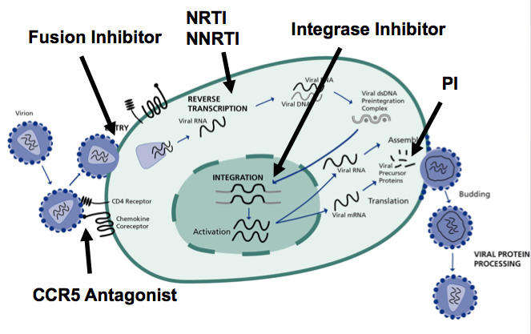
HIV life cycle and the point of action of ARVs.

Slide 49
INTRODUCTION TO HAART.
Antiretroviral Therapy in Infants, Children, Adolescents, and Adults

Slide 50
The goal of ART is to suppress viral replication with the aim of reducing the patient’s VL to undetectable levels
All individuals with confirmed HIV infection are eligible for ART, irrespective of CD4 count/%, WHO clinical stage, age, pregnancy or breastfeeding status, co-infection status, risk group, or any other criteria, PROVIDED that the individual is willing and ready to take ART and adhere to follow-up recommendations
ART should be started in all patients as soon as possible (preferably within 2 weeks of confirmation of HIV status)

Slide 51
Preferred First-line ART for infants, children, adolescents and adults
AGE | REGIMEN.
<2 Weeks | AZT + 3TC + NVP
2 weeks - < 4 weeks: | AZT + 3TC + LPV/r
4 weeks - < 3 years: | ABC + 3TC + LPV/r
3 - 15 years (< 35 kg body weight): | ABC + 3TC + EFV
3 - 15 years ( 35 kg body weight): | TDF + 3TC + EFV
>15 years: | TDF + 3TC + EFV

Slide 52
Routine viral load (VL) testing is recommended for monitoring ART and identifying treatment failure. A VL test should be carried out at 6 and 12 months after initiation of ART and annually thereafter if the VL is < 1,000 copies/ml.
Treatment failure is defined by a persistently high viral load 1,000 copies/ml (two viral loads measured within a 3-month interval with adherence support between measurements) after at least 6 months of using ART.

Slide 53
PMTCT.
Prevention of mother-to-child transmission of HIV (PMTCT) should be offered as part of a comprehensive package of fully integrated, routine antenatal care interventions
ART should be initiated in all pregnant and breastfeeding women living with HIV, regardless of gestational age, WHO clinical stage and at any CD4 count, and continued lifelong
ART should be started, ideally, on same day as HIV diagnosis with ongoing enhanced adherence support including community-based case management and support

Slide 54
PMTCT.
Start on TDF/3TC/EFV (300/300/600 mg), as FDC, 1 tab once daily.
For women exposed to single dose NVP (without AZT+3TC as part of PMTCT) within the past 2 years: use ATV/r instead of EFV
For patients already on ART, continue ART unless the regimen or part of the regimen is contraindicated because of the pregnancy.

Slide 55
ARV PROPHYLAXIS FOR HEI.
12 weeks of infant prophylaxis:
- AZT+NVP for 6 weeks,followed by NVP for 6 weeks
DBS for PCR at first contact, following EID algorithm

Slide 56
POST EXPOSURE PROPHYLAXIS
RISK ASSESSMENT AFTER EXPOSURE TOBODY FLUIDS.
 | Low Risk | High Risk.
Type of exposure | Intact skin | Mucous membrane/non intact skin Percutaneous injury.
Source | HIV Negative | HIV status unknown Clinically well/unwell.
Material. | Saliva tears, sweat faeces, urine, sputum, Vomit. | Semen vaginal secretions, synovial,pleural,pericardial, peritoneal,amniotic fluid. Blood and body fluids: CSF; Viral cultures in lab.

Slide 57
POST EXPOSURE PROPHYLAXIS(PEP).
ARVs for Post-exposure Prophylaxis (PEP)
PEP should be ordered as soon as possible (< 72 hours) after high risk exposure.
The recommended ARV agents for PEP are:
TDF + 3TC + ATV/r for 28 days (adolescents and adults)
ABC + 3TC + LPV/r for 28 days (children)

Slide 58
PRE- EXPOSURE PROPHYLAXIS (PrEP).
Oral PrEP containing TDF should be offered to HIV negative individuals at substantial ongoing risk of HIV infection
PrEP may be offered to the HIV seronegative partner in a sero-discordant relationship during attempts to conceive (as part of a pre-conception care plan for the couple)
The recommended ARV regimen for use as PrEP is:
TDF 300 mg and Emtricitabine 200 mg once daily (given as a FDC)
PrEP does not eliminate the risk of HIV infection and it does not prevent STIs or unintended pregnancies
PrEP should only be offered after thorough assessment to establish eligibility, readiness for effective use, required follow-up and absence of contraindications to TDF and/or FTC

Slide 59
People who inject drugs(PWID)
PWID should be offered regular HIV testing and counselling and be linked to comprehensive HIV treatment and prevention services including harm reduction counselling and support
Screening, diagnosis, treatment and prevention of STIs should be offered routinely as part of comprehensive HIV prevention and care for PWID
PWID should have the same access to TB prevention, screening and treatment services as other populations at risk of or living with HIV
PWID should be screened for HBV (by HBsAg) and HCV (by HCV serology) at first contact
All PWID should be linked to Needle and Syringe Programmes (NSP) to access sterile injecting equipment
All PWID should be linked to Medically Assisted Therapy (MAT)

Slide 60
HAART FIXED DOSE COMBINATION.
Fixed dose combination
Abacavir (ABC) + Lamivudine (3TC) | Zidovudine (AZT) + Lamivudine (3TC) | Zidovudine(ZDV) + Lamivudine(3TC) + Nevirapine (NVP).
Vital in reducing pill burden.

Slide 61
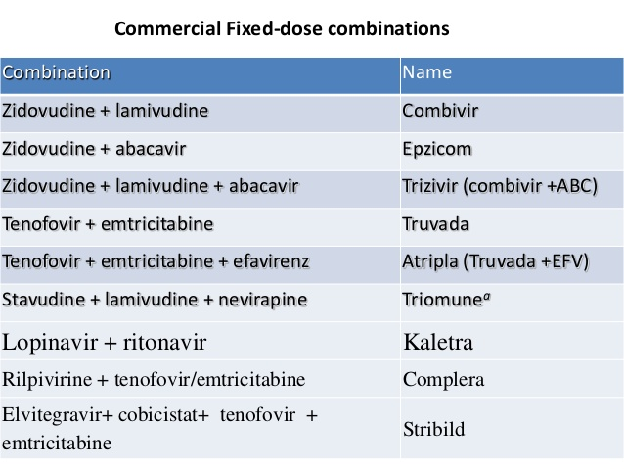
HAART FIXED DOSE COMBINATIONS.

Slide 62
ADHERENCE
What is adherence
- Following a care plan as agreed with the healthcare team
- Attending clinic appointments as scheduled
- Picking up medicines and taking them as prescribed
- Getting lab tests according to the recommended schedule
- Following nutritional recommendations

Slide 63
ADHERENCE.
How should ART be taken
- You must take the correct dosage. If you take less than the dose prescribed the treatment won’t be effective and will result in resistance and treatment failure.
Never share your ART with someone else
- For children, the dosage keeps changing as they grow

Slide 64
ADHERENCE.
- You must take ART the correct time of day:
. If your ART is supposed to be taken once per day, then pick a time when it will usually be convenient for you to remember, e.g. with dinner every day.
If you are late taking your dose, you can still take it up to 12 hours later, and then continue with your regular schedule (e.g. if you take it at 7.00 pm every evening but forget to take it one evening, you can still take it up to 7.00 am the next morning, and then continue with your regular schedule at 7.00 pm again.
If you are more than 12 hours late you should skip the dose and just wait for your next one at 7.00 pm)

Slide 65
CLINICAL HIV COUNSELLING AND TESTING.

Slide 66
DEFINITION.
Counseling is a professional relationship between two or more people, one of whom is a trained counselor, and the other(s), a person or persons undergoing therapy.
The relationship is aimed at helping the counselee identify his/her own strength and use it to solve their problems.

Slide 67

COUNSELLING.

Slide 68
ROLE OF HIV COUNSELLING.
The role of counseling in HIV services is to help people to:
(i) Understand their situation more clearly
(ii) Make choices which fit their values, feelings and needs
(iii) Cope better with a problem that they are facing
(iv) Develop skills such as being able to talk about sex with their partner
(v) Provide support for others whilst preserving their own strength

Slide 69
PRINCIPLES OF UNIVERSAL HIV TESTING.
HIV Testing services should be available and accessible to all
Confidentiality must be maintained when conducting all types of HIV testing
Person receiving HIV testing should give consent prior to testing.
People wishing to be tested are entitled to adequate information before and after testing
Quality of testing services should be ensured including strict adherence to outlined steps in algorithms

Slide 70
HIV TESTING ALGORITHMS.
There are two major HIV testing algorithms as per the national guidelines listed below:
i. Rapid Testing algorithm: This is a combination of a screening and confirmatory test for HIV diagnosis: using simple rapid tests.
ii. Early Infant Diagnosis algorithm: This involves the use of Polymerase chain reaction

Slide 71
HIV TESTING APPROACHES.
1) CITC-Client Initiated Testing and Counseling
2) PITC-Provider Initiated Testing and Counseling

Slide 72
HIV TESTING SETTINGS.
Community based settings
➢ Stand –alone VCT
➢ Outreach HIV Testing and Counseling
➢ Home based testing and counseling
➢ Work place HIV testing and counseling
Health facility settings
➢ Integrated VCT (this refers to a VCT centre located within a health facility)
➢ HIV testing and counseling offered at all service delivery points within a health facility.

Slide 73
PROCESS OF TESTING AND COUNSELLING.
PROVIDER INITIATED TESTING AND COUNSELLING.

Slide 74
By the end of this unit, you should be able to:
1. Describe the components of HIV testing and counseling protocol
2. Conduct a pre-test counseling session
3. Conduct a post-test counseling session

Slide 75
PACKAGE OF HIV TESTING SERVICES.
An HIV testing and counselling session consists of:
A pre-test session
HIV test
A post-test session
Assessment for other health-related conditions or needs
Referral and linkage to other appropriate health services

Slide 76
Pre-Test Counseling Session
The pre-test session introduces basic HIV information to the client or patients wishing to receive an HIV test. It may be provided to an individual, a couple, or a group.
Group information is not a substitute for individual or couples counseling.
Whether attending as an individual, a couple, or a group, all persons should be given time to ask questions and receive personalized information prior to giving consent for receiving HTC services.

Slide 77
SERVICES PROVIDED DURING A PRE TEST COUNSELLING.
a) Information on the benefits of knowing one’s HIV status
b) Discussion on clients personal risk (risk assessment)
c) HIV prevention (risk reduction)
d) Basic HIV information
e) An explanation of the HIV testing process
f) The need for consent for the HIV test
g) Referral to support, care and treatment
h) Importance of disclosure to partners and other family members

Slide 78
HIV TESTING
Perform test using approved rapid HIV antibody test kit

Slide 79
POST TEST COUNSELLING.
Post-test counselling for negative results
Post-test counselling for positive results
Risk reduction plan
Linkage to other HIV prevention services
Re-testing where applicable
Enrolment into treatment and prevention**
Risk reduction and positive living counselling
Partner/family testing

Slide 80
RETESTING HIV NEGATIVE CLIENTS.
SCENARIO/POPULATION | RECOMMENDATION FOR RE-TESTING.
General population. | Re-test annually (for children, re-testing is only required if there is a new exposure)
Key populations | Re-test every 3 months in case of frequent instances of high risk exposure
Negative partner in discordant union. | Re-test at the initiation of ART for the HIV positive partner,and every 3 months until HIV-positive partner achieves viral suppression. Once viral suppression is confirmed re-testing can be performed every 6 months. Other prevention services should still be recommended, including consistent and correct use of condoms. Assess for eligibility and willingness for PrEP

Slide 81
RETESTING HIV NEGATIVE CLIENTS.
SCENARIO/POPULATION | RECOMMENDATION FOR RETESTING.
Pregnant Women. | Test in first trimester or first contact; re-test in the third trimester. All women who were not tested during the third trimester should be tested during labour and delivery
Breastfeeding Mothers. | Re-test after delivery at 6 weeks, at 6 months then follow testing recommendations as per their risk category
Persons who had a most recent (e.g. less than a month) specific exposure incidence | Test at initial presentation and re-test at 4 weeks, if negative, test again at 12 weeks after which annual re-testing applies
PWID | Re –test every three months.
Individuals on pre-exposure Prophylaxis (PrEP) | Re –test every three months.

Slide 82
POST TEST COUNSELLING IN THE ERA OF TEST AND TREAT.
With the 2016 ART guidelines all PLHIV now qualify for ART irrespective of WHO Clinical Stage, CD4 count, age, gender, pregnancy status, co-infection status, etc.
Post-test counselling should, at a minimum, include three key messages that begin the ART treatment preparation process for all PLHIV:
Treatment (called antiretroviral therapy or ART) is available and is recommended for everyone with HIV
Starting treatment as soon as possible (preferably within two weeks of testing positive for HIV) reduces the chance of your illness getting worse or of passing HIV to others
If you take your ART properly and do not miss pills you can expect to live a long and productive life

Slide 83
Assessment of other health-related conditions or needs
HTS provider should assess all clients for other health related conditions/issues, e.g.:
Tuberculosis
STIs and cancer screening
eMTCT
Family planning
Alcoholism
Psychosocial issues
Gender-based violence
VMMC
Non-communicable diseases

